Slide 1
Sustainable Solutions for a New Decade
- The Noosa story

Slide 2
3 Key Learning Outcomes
1. Volunteer influencer group + regional businesses = combat business challenges (rising power prices).
2. Evidence based research → priority actions = sustainable business practices (diverse industries) &
3. Sharing ideas & actions to reduce regional (business) emissions.

Slide 3
Business Case Study Highlights
https://www.zeroemissionsnoosa.com.au/case-study-videos

Slide 4
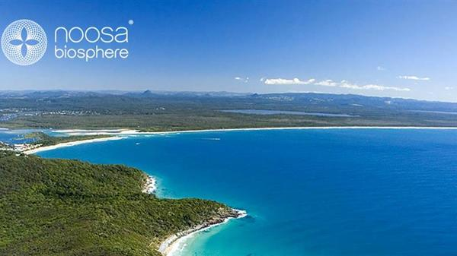
Background - The Noosa Context
2007 Noosa Council Biosphere reserve
(UNESCO Man &
Biosphere (MaB)
program.
NSC = regional
Influencer.

Slide 5
Background - The Noosa Context
2016 Noosa Council emissions reduction policy Target = zero net greenhouse gas emissions by 2026 (Council).
2017 Zero Emissions Noosa Inc. (ZEN) formed. Community initiator & regional influencer → ↓ regional energy use = Noosa Community net zero greenhouse gas emissions by 2026.

Slide 6
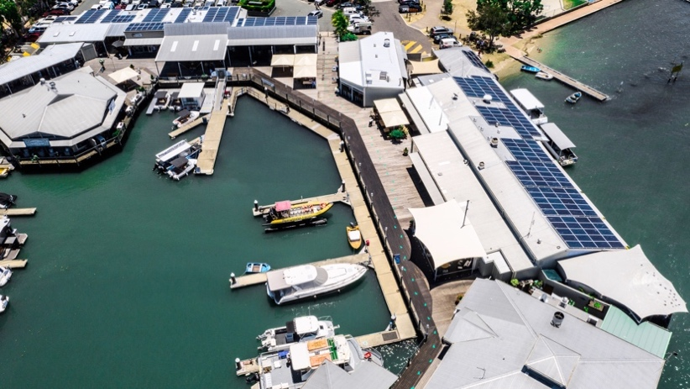
ZEN Inc. = 3 main foci
Residential
Transport
Business

Slide 7
The Size of the Task
2018 Electricity costs Noosa LGA
$77M per year for grid electricity
$27M per year from business
55GWH solar power energy produced & used locally, keeps about $13.75m in Noosa.
Source: ACCC Energy Affordability Data.

Slide 8
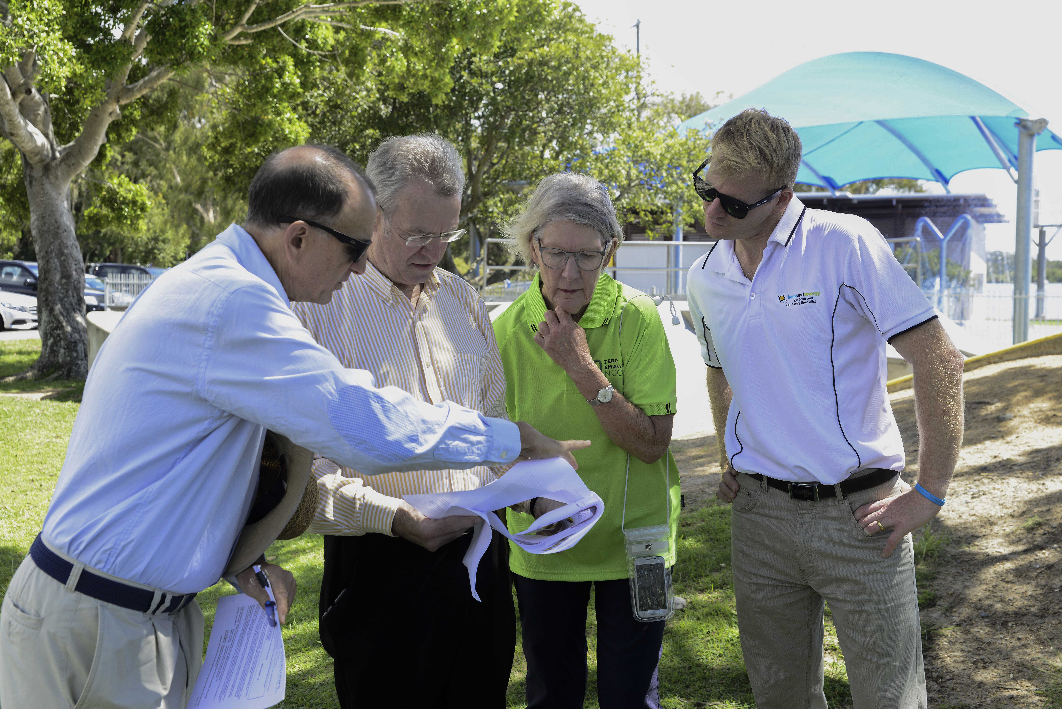
How can ZEN Inc. Help Noosa to be Sustainable, Save $ and Reduce Emissions?
“Achieving 100% Renewable
Electricity in Noosa”
(NBRF funded)
Why - business solar
uptake so low?
Barriers to solar uptake? &
Reasons for these barriers?
Key findings:
Solar = best option for Noosa to reduce electricity related emissions &
< 5% of Noosa businesses were solar powered!

Slide 9
How can ZEN Inc. Help Noosa to be Sustainable, Save $ and Reduce Emissions?
“Repower Noosa Report: Barriers & Benefits of Solar for Business” (Noosa Council funded)
Key findings re barriers:

Slide 10
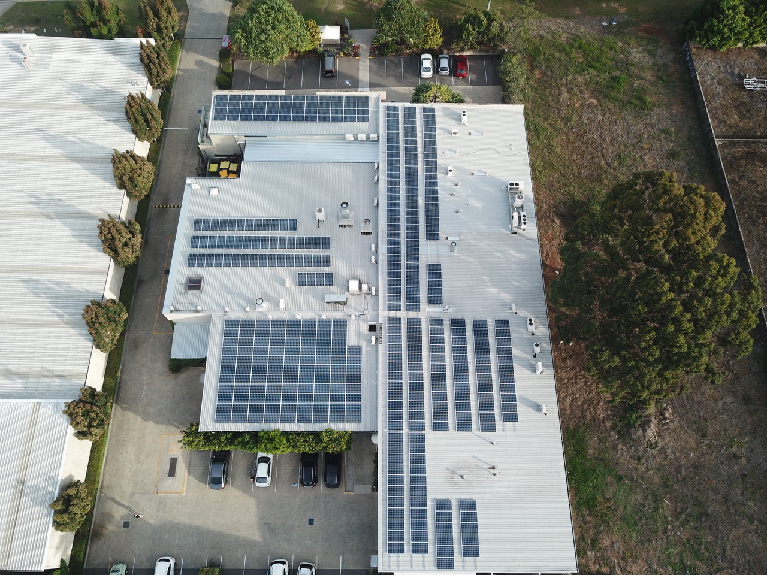
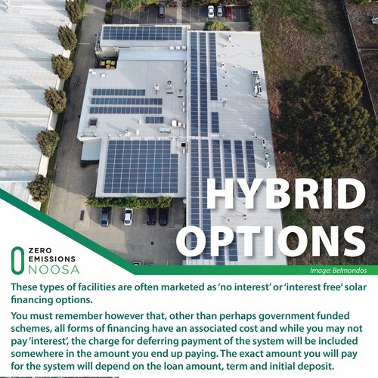
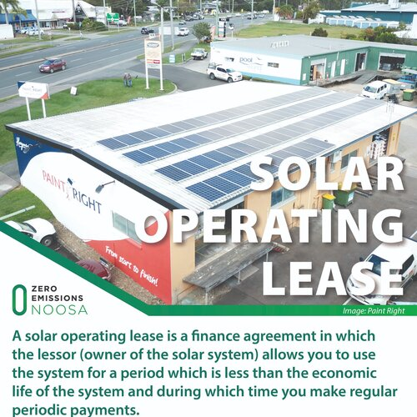
How is ZEN Inc. working with Noosa Businesses? – Resources, Tools, Forums
https://www.zeroemissionsnoosa.com.au/
To help them to:
be better informed and
to ask the right questions

Slide 11
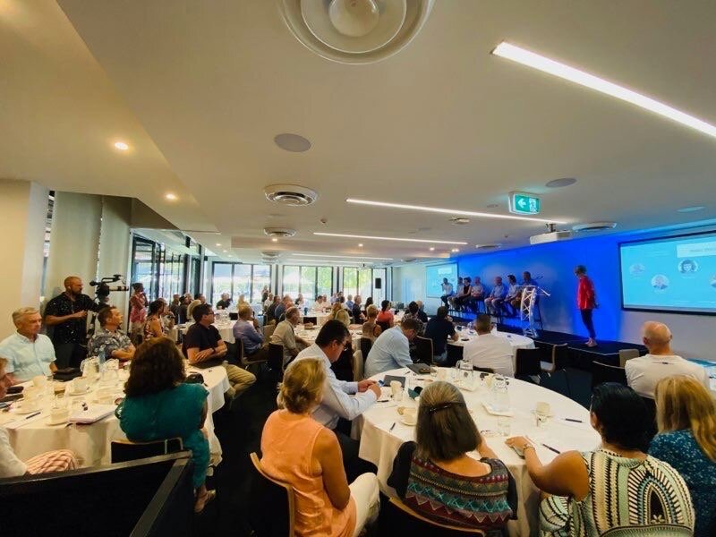
How is ZEN Inc. working with Noosa Businesses? – Resources, Tools, Forums
7 EASY STEPS FOR SOLAR FOR STRATA

Slide 12
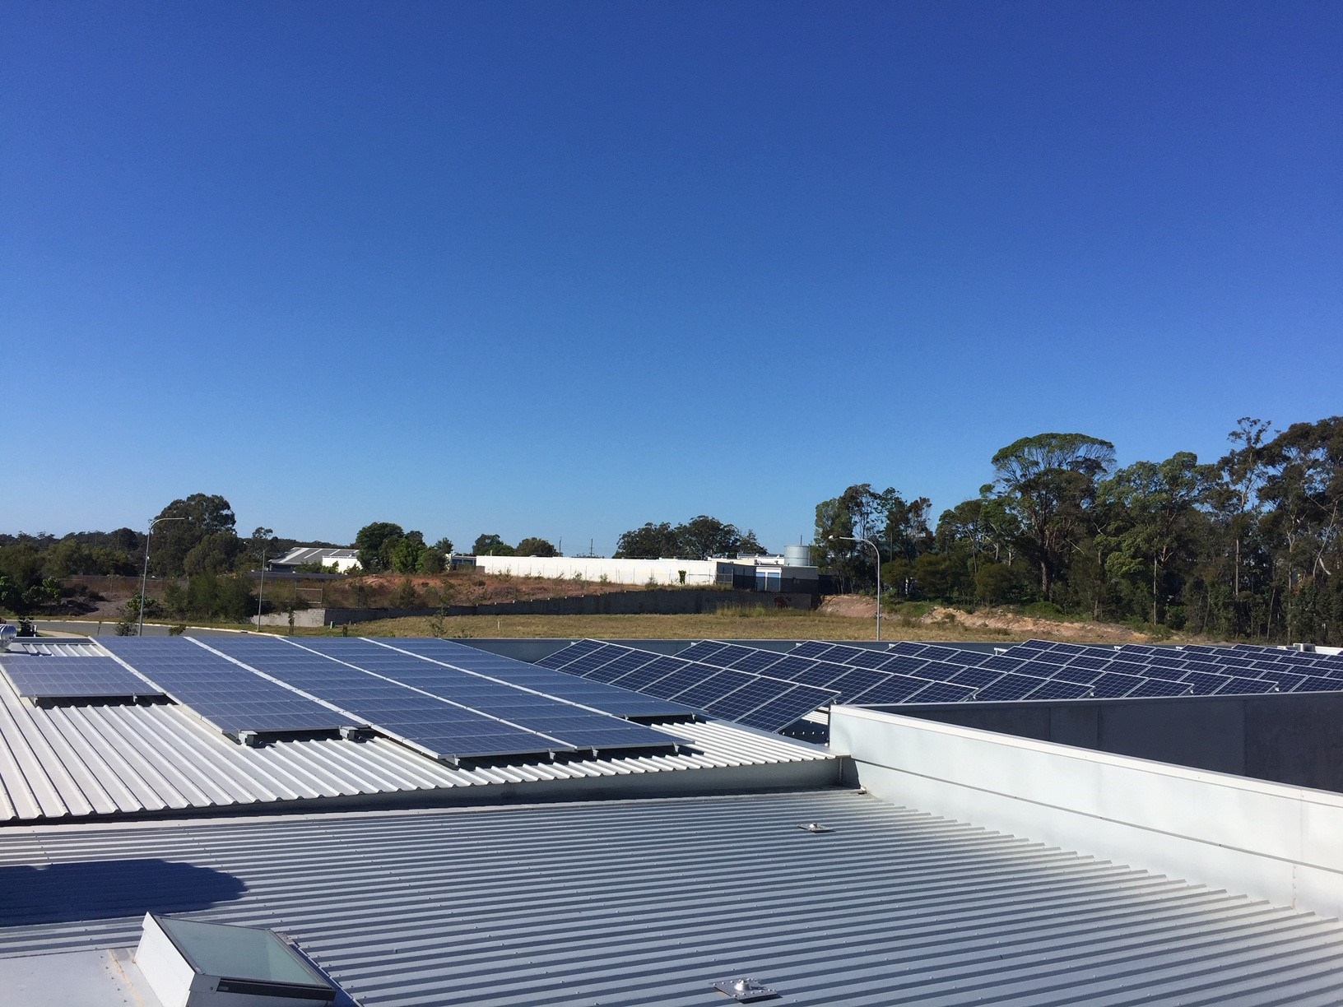
Outcomes – Has ZEN Inc. helped businesses beat rising power prices?
2009 -2019: 11% ↓ Noosa LGA grid consumption (on 2009 levels). Pop. ↑ by 10%.
May 2018 - June 2019: 175% ↑ Noosa businesses with solar power.
2018 – 2019: 5% to 13% ↑ Noosa solar power from business.
Source Based on data from: Energex & Australian PV Institute (APVI)
and ITP Renewables report.

Slide 13
Noosa Business Case studies
Case study businesses solar PV systems:
Payback periods averaged: 2 – 5 years
Power bills reduced: Between 33% & 100%.
Noosa Marina, Warren Smith, General Manager: “It’s a no brainer figures wise. It certainly does stack up.”
Andrew’s A Grade Mechanical: “I’m blown away by how well this system works, it’s good stuff.”
Paint Rite, Mason Powell: “We have been surprised at how easy it was…….we will definitely be installing solar on our other 2 sites”.
Noosa Sun Motel, Darren Kennan, Manager: “We expected it would take about 5 years to pay off but ….it has paid for itself in 2 years…..”
Interior designer & builder, Di Henshall – “Always Look to the future…. You are future proofing your business… It’s a sound economic and environmental business decision.”

Slide 14
Conclusion – Learning Outcomes
ZEN Inc. is a volunteer regional influencer – working strategically with Noosa businesses to combat business challenges (rising power prices).
Studies: Evidence based research → priority actions = sustainable business practices (diverse industries).
ZEN Inc. - Sharing ideas & actions to reduce regional (business) emissions.
To help Noosa reach it target of net zero greenhouse gas emissions by 2026.

Slide 15
Limitations for the Future?
2020 major focus was on business take up of rooftop solar BUT
COVID 19
Enthusiasm – vast majority of this work has been done by volunteers.
Funding
Time &
Business “buy in” as currently they focus on business survival.

